Slide 1
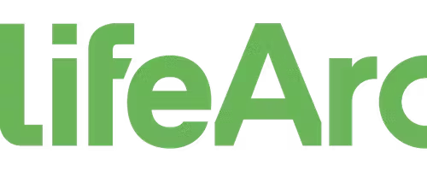
A unified Science Data Fabric for :
Benefits, Risks, and Considerations
Gintarė Bučaitė, PhD
Interview seminar, LifeArc
Data Engineer (Systems Engineer) – Data Science
2023 June

Slide 2
LifeArc and its current data challenges
LifeArc exists to help transform early stage, promising science into medical interventions to improve human health and benefit society.
Challenge: Growth of LifeArc has led to internal and external data silos limiting the availability of experimental data.
Data silos lead to a plethora of problems:
Inefficient data access and collaboration: challenging for teams to access and collaborate on critical data, leading to inefficiencies, duplicated efforts, and delays in decision-making.
Reduced data visibility and insights: without a unified view, valuable insights and patterns that could drive innovation and strategic decision-making remain hidden, limiting the organization's competitive advantage
Hindered data integration and analysis: siloed data complicates the process of integrating and analyzing information from different sources as it requires significant effort and resources to transform and reconcile data
Impaired data quality and consistency: this inconsistency can lead to data inaccuracies, redundancies, and conflicts, reducing the trustworthiness of the information and hindering effective data-driven decision-making
Increased operational costs and IT complexity: managing multiple data silos requires maintaining separate infrastructure, data storage systems, and tools for each isolated data source
LifeArc
LifeArc
Collaborator
Notes:
Inefficient Data Access and Collaboration: Data silos result in isolated pockets of information within an organization. This makes it challenging for teams to access and collaborate on critical data, leading to inefficiencies, duplicated efforts, and delays in decision-making.
Reduced Data Visibility and Insights: Data silos restrict the ability to gain a comprehensive view of the organization's data. Without a unified view, valuable insights and patterns that could drive innovation and strategic decision-making remain hidden, limiting the organization's competitive advantage.
Hindered Data Integration and Analysis: Siloed data complicates the process of integrating and analyzing information from different sources. It requires significant effort and resources to transform and reconcile data, making it difficult to derive meaningful conclusions or identify relationships and trends that could drive breakthrough discoveries or process improvements.
Impaired Data Quality and Consistency: Data silos often result in inconsistent data quality standards across different departments or systems. This inconsistency can lead to data inaccuracies, redundancies, and conflicts, reducing the trustworthiness of the information and hindering effective data-driven decision-making.
Increased Operational Costs and IT Complexity: Managing multiple data silos requires maintaining separate infrastructure, data storage systems, and tools for each isolated data source. This duplication of resources increases operational costs and creates unnecessary complexity for IT teams, making it harder to maintain and secure the data effectively.

Slide 3
Unified Science Data Fabric to break Data Silos
Challenge: Growth of LifeArc has led to internal and external data silos limiting the availability of experimental data.
Solution: Data Fabric approach operating on FAIR (Findable, Accessible, Interoperable, and Reusable) principles
A Science Data Fabric is a unified platform or framework that integrates and harmonizes diverse scientific and experimental data from multiple sources and formats.
It operates on FAIR data principles, enabling seamless data discovery, integration, and collaboration while maintaining data integrity and security.
LifeArc
LifeArc
Collaborator
Notes:
Enhanced Data Accessibility and Discoverability: A Science Data Fabric promotes data accessibility by providing a centralized, unified platform where data from multiple sources and formats can be easily discovered and accessed. Researchers and collaborators can find and retrieve relevant data quickly, eliminating the need to navigate through multiple silos or rely on manual data requests.
Improved Collaboration and Knowledge Sharing: By embracing FAIR principles within a Science Data Fabric, organizations can facilitate seamless collaboration and knowledge exchange among researchers, internal teams, and external partners. It fosters an environment where data can be shared, reused, and built upon, enabling interdisciplinary collaborations, accelerating research, and generating novel insights.
Accelerated Innovation and Time-to-Discovery: A Science Data Fabric enables researchers to harness the full potential of available data resources, leading to faster discoveries and innovation. By breaking down data silos and providing an integrated view of data, scientists can leverage a broader range of data for analysis, hypothesis testing, and experimental design, ultimately accelerating scientific breakthroughs.
Streamlined Data Integration and Analysis: A unified Science Data Fabric simplifies the process of integrating and analyzing data from disparate sources. It enables seamless integration of diverse datasets, including experimental data, clinical data, and external datasets, reducing the effort required for data transformation and enabling comprehensive analysis that can uncover hidden patterns and insights.
Robust Data Governance and Security: Adopting FAIR principles within a Science Data Fabric facilitates robust data governance practices and ensures data security. Clear metadata standards, data stewardship roles, and access controls can be established to maintain data integrity, privacy, and comply with regulatory requirements. Additionally, centralized security measures can be implemented, including encryption, authentication, and monitoring, to safeguard the fabric against cybersecurity threats.

Slide 4
Potential Benefits of a Science Data Fabric
Benefits of Science Data Fabric approach
Enhanced data accessibility and discoverability: provides a centralized, unified platform where data from multiple sources and formats can be easily discovered and accessed
Improved collaboration and knowledge sharing: fosters an environment where data can be shared, reused, and built upon, enabling interdisciplinary collaborations, accelerating research, and generating novel insights.
Accelerated innovation and time-to-discovery: scientists can leverage a broader range of data for analysis, hypothesis testing, and experimental design, ultimately accelerating scientific breakthroughs
Streamlined data integration and analysis: simplifies the process of integrating and analyzing data from disparate sources
Robust data governance and security: clear metadata standards, data stewardship roles, and access controls can be established to maintain data integrity, privacy, and comply with regulatory requirements
Notes:
Enhanced Data Accessibility and Discoverability: A Science Data Fabric promotes data accessibility by providing a centralized, unified platform where data from multiple sources and formats can be easily discovered and accessed. Researchers and collaborators can find and retrieve relevant data quickly, eliminating the need to navigate through multiple silos or rely on manual data requests.
Improved Collaboration and Knowledge Sharing: By embracing FAIR principles within a Science Data Fabric, organizations can facilitate seamless collaboration and knowledge exchange among researchers, internal teams, and external partners. It fosters an environment where data can be shared, reused, and built upon, enabling interdisciplinary collaborations, accelerating research, and generating novel insights.
Accelerated Innovation and Time-to-Discovery: A Science Data Fabric enables researchers to harness the full potential of available data resources, leading to faster discoveries and innovation. By breaking down data silos and providing an integrated view of data, scientists can leverage a broader range of data for analysis, hypothesis testing, and experimental design, ultimately accelerating scientific breakthroughs.
Streamlined Data Integration and Analysis: A unified Science Data Fabric simplifies the process of integrating and analyzing data from disparate sources. It enables seamless integration of diverse datasets, including experimental data, clinical data, and external datasets, reducing the effort required for data transformation and enabling comprehensive analysis that can uncover hidden patterns and insights.
Robust Data Governance and Security: Adopting FAIR principles within a Science Data Fabric facilitates robust data governance practices and ensures data security. Clear metadata standards, data stewardship roles, and access controls can be established to maintain data integrity, privacy, and comply with regulatory requirements. Additionally, centralized security measures can be implemented, including encryption, authentication, and monitoring, to safeguard the fabric against cybersecurity threats.

Slide 5

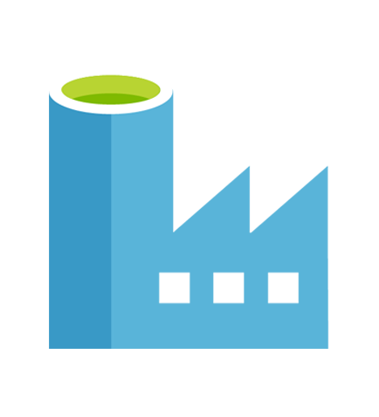
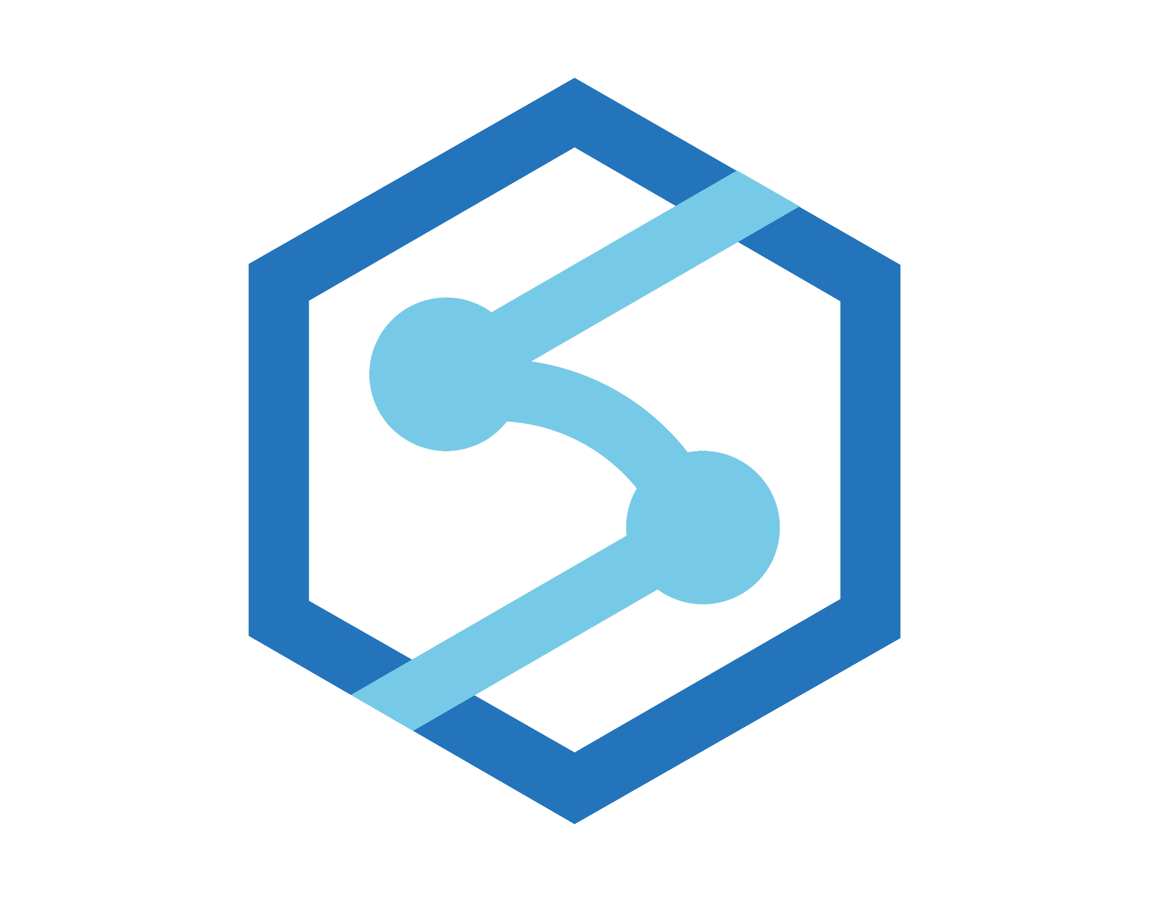
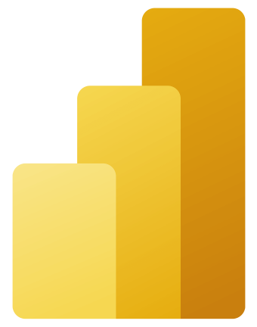

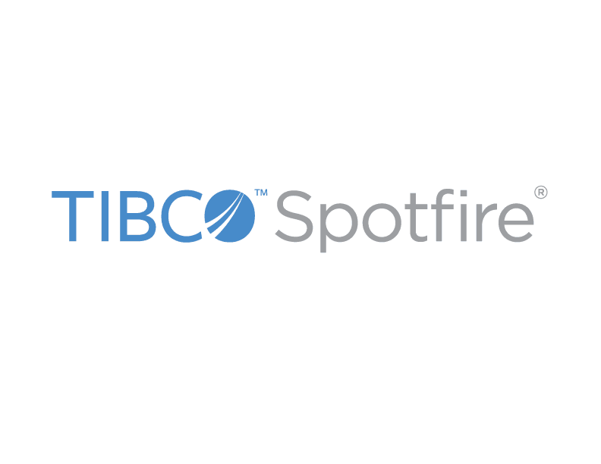

Science Data Fabric for LifeArc Data
Without further background information about the data structures and needs at LifeArc available, the initial proposal to consider could be a traditional data fabric implementation.
It will be crucial to consider existing infrastructure, LifeArc’s data needs, integrations with any custom or proprietary applications and future requirements.
By leveraging a platform solution, LifeArc can establish a unified Science Data Fabric that integrates data from multiple sources, enables collaboration, and provides secure and scalable analytics capabilities.
Logs, files and media - unstructured data
Ingest
Prep and Train
Model and Serve
Visualise
IoT hub
ADF
Data Bricks
Synapse
Power BI/Spotfire
Store
Scientific data platform (e.g. Dotmatics, CDD) - structured data
Raw
Curated
Published
Notes:
Azure Data Factory can be used to create data pipelines that extract, transform, and load (ETL) data from different sources into Azure Data Lake Storage.
Data Factory can orchestrate the movement of data, perform data transformations, apply data quality checks, and schedule data ingestion processes.
Data Lake Storage Gen2 converges the capabilities of Azure Data Lake Storage Gen1 with Azure Blob Storage. For example, Data Lake Storage Gen2 provides file system semantics, file-level security, and scale. Because these capabilities are built on Blob storage, you also get low-cost, tiered storage, with high availability/disaster recovery capabilities.
Azure Databricks is a data analytics platform. Its fully managed Spark clusters process large streams of data from multiple sources. Azure Databricks cleans and transforms structureless data sets. It combines the processed data with structured data from operational databases or data warehouses. Azure Databricks also trains and deploys scalable machine learning and deep learning models.
Azure Synapse is an analytics service for data warehouses and big data systems. This service integrates with Power BI, Machine Learning, and other Azure services.
Power BI is a collection of software services and apps. These services create and share reports that connect and visualize unrelated sources of data. Together with Azure Databricks, Power BI can provide root cause determination and raw data analysis.

Slide 6
Potential risks of implementing Science Data Fabric
Technical Complexity and Scalability
Risk: Complexity in implementing and maintaining the Science Data Fabric
Mitigation: Training and skill development, cloud consultants or partners, scalable cloud infrastructure
Change Management; User Adoption
Risk: Resistance to new workflows and processes
Mitigation: Change management activities, stakeholder involvement, user-friendly interfaces and tools
Data Privacy and Security
Risk: Data breaches and unauthorized access
Mitigation: Strong access controls, encryption, regular security audits, compliance with data protection regulations.
Data Quality and Integrity
Risk: Inaccurate, incomplete or inconsistent data
Mitigation: Data validation, automated cleansing, quality assessments, data stewardship.
Integration and Interoperability
Risk: Challenges in integrating diverse data sources
Mitigation: Robust data integration processes, standardized formats, data governance practices
Notes:
Enhanced Data Accessibility and Discoverability: A Science Data Fabric promotes data accessibility by providing a centralized, unified platform where data from multiple sources and formats can be easily discovered and accessed. Researchers and collaborators can find and retrieve relevant data quickly, eliminating the need to navigate through multiple silos or rely on manual data requests.
Improved Collaboration and Knowledge Sharing: By embracing FAIR principles within a Science Data Fabric, organizations can facilitate seamless collaboration and knowledge exchange among researchers, internal teams, and external partners. It fosters an environment where data can be shared, reused, and built upon, enabling interdisciplinary collaborations, accelerating research, and generating novel insights.
Accelerated Innovation and Time-to-Discovery: A Science Data Fabric enables researchers to harness the full potential of available data resources, leading to faster discoveries and innovation. By breaking down data silos and providing an integrated view of data, scientists can leverage a broader range of data for analysis, hypothesis testing, and experimental design, ultimately accelerating scientific breakthroughs.
Streamlined Data Integration and Analysis: A unified Science Data Fabric simplifies the process of integrating and analyzing data from disparate sources. It enables seamless integration of diverse datasets, including experimental data, clinical data, and external datasets, reducing the effort required for data transformation and enabling comprehensive analysis that can uncover hidden patterns and insights.
Robust Data Governance and Security: Adopting FAIR principles within a Science Data Fabric facilitates robust data governance practices and ensures data security. Clear metadata standards, data stewardship roles, and access controls can be established to maintain data integrity, privacy, and comply with regulatory requirements. Additionally, centralized security measures can be implemented, including encryption, authentication, and monitoring, to safeguard the fabric against cybersecurity threats.

Slide 7
Science Data Fabric for LifeArc: Conclusion
Embracing a Science Data Fabric operating on FAIR principles enables LifeArc to overcome data silos and harness the full potential of its experimental and collaborator-generated data.
The Science Data Fabric promotes data accessibility, collaboration, and innovation, leading to faster discoveries and insights.
By leveraging robust and secure platforms, such as Azure, LifeArc can automate data ingestion, integrate diverse data sources, and ensure data governance and security.
Mitigating risks such as data privacy, quality, integration challenges, technical complexity, and user adoption is crucial for successful implementation.
Adopting a Science Data Fabric empowers LifeArc to make data-driven decisions, accelerate research, and enhance scientific collaborations.

Slide 8
Q & A
Gintarė Bučaitė, PhD
Interview seminar, LifeArc
Data Engineer (Systems Engineer) – Data Science
2023 June

